Slide 1
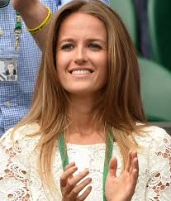
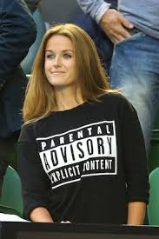
Judging a book by the cover

Slide 2
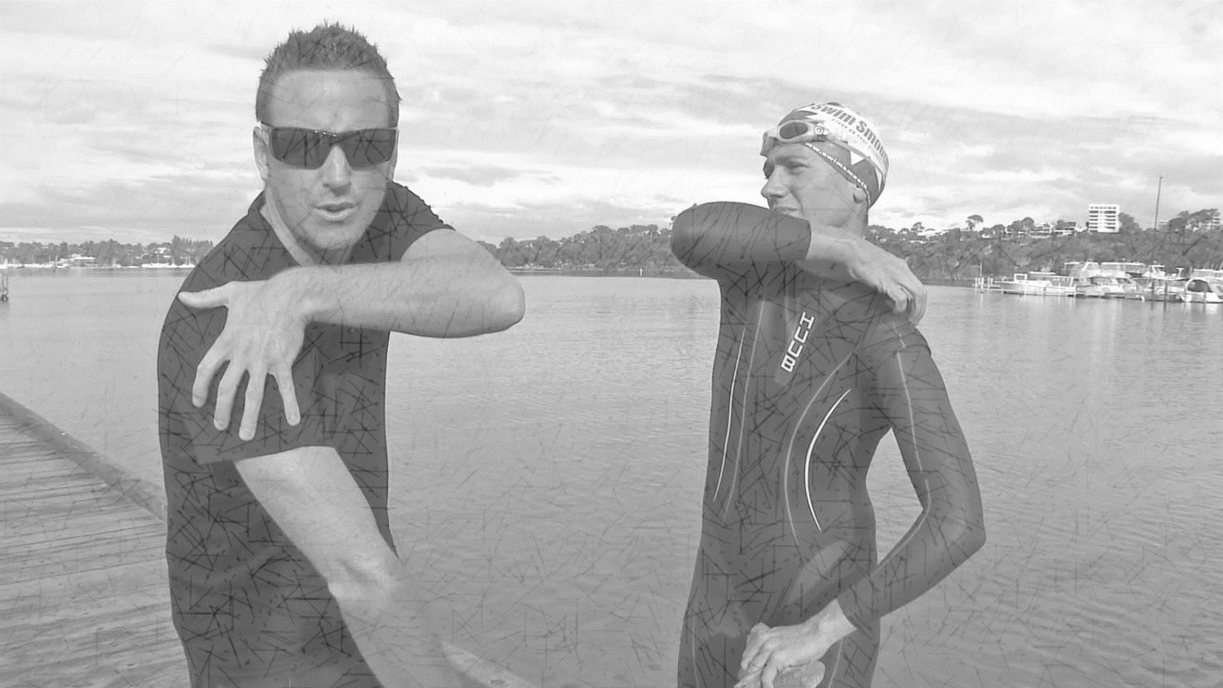
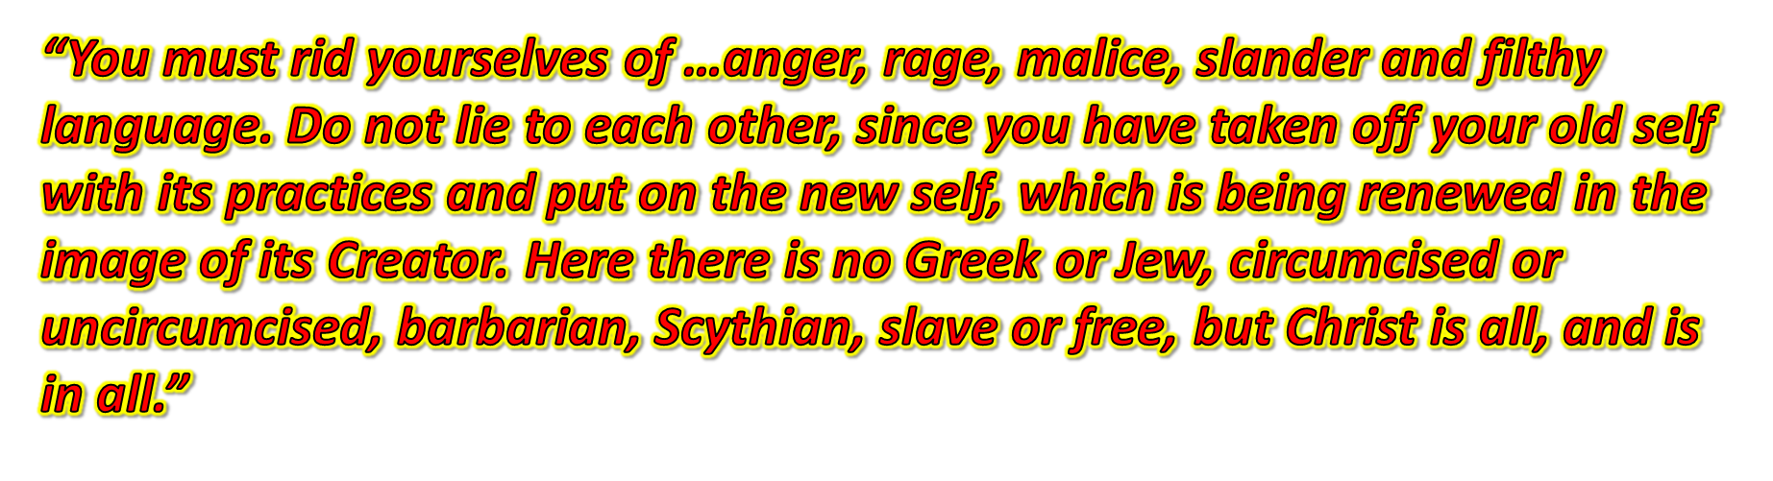
A change of clothes
Taking off the old
Colossians 3:7-11

Slide 3
Col 3v12-14 – Come as you are
¹² Therefore, as God’s chosen people, holy and dearly loved, clothe yourselves with compassion, kindness, humility, gentleness and patience. ¹³ Bear with each other and forgive one another if any of you has a grievance against someone. Forgive as the Lord forgave you. ¹⁴ And over all these virtues put on love, which binds them all together in perfect unity.

Slide 4
Col 3v12-14 – Come as you are
¹² Therefore, as God’s chosen people, holy and dearly loved
Writing to ordinary believers in 1st century Colossae
  Bombarded with false teaching by spiritual elite
  What could be better than Paul’s description?
And a call to excellence
  v10 “the new self which is being renewed in the image of its Creator.”

Slide 5
How should holy people dress?
¹² Therefore, as God’s chosen people, holy and dearly loved clothe yourselves with compassion, kindness, humility, gentleness and patience.
A present imperative to dress well
  “put them on and keep putting them on”

Slide 6
How should holy people dress?
First virtue:-
Clothe yourselves with compassion,
Heart of compassion
Bowels of compassion
  Moved in our inner person
  Sympathy leading to action, not apathy
  Good deeds done for the needs of others James 2v15-16

Slide 7
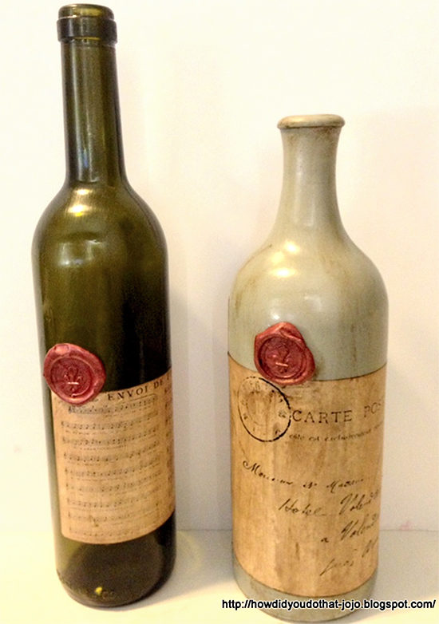
How should holy people dress?
First virtue compassion
Second virtue kindness
Winston Churchill v George Bernard Shaw
Mellowed, lost its harshness

Slide 8
How should holy people dress?
First virtue compassion
Second virtue kindness
Winston Churchill v George Bernard Shaw
Mellowed, lost its harshness
Always ready to serve the needs of others
Powerful Rom 2v4
  “Or do you show contempt for the riches of His kindness, tolerance and patience, not realizing that God’s kindness leads you towards repentance”

Slide 9
How should holy people dress?
First virtue compassion
Second virtue kindness
Third virtue humility
“Greek perspective” contempt
“The surest mark of true conversion is humility” J.C. Ryle
“Humility begins with a right concept of God as one who is infinite and eternal in His majesty and holiness” Jerry Bridges

Slide 10
How should holy people dress?
First virtue compassion
Second virtue kindness
Third virtue humility
God’s wisdom/way of the Master
  Phil 2v8 “being found in appearance as a man, He humbled Himself and became obedient to death – even death on a cross”
  Phil 2v5 “your attitude should be the same as that of Jesus”

Slide 11
How should holy people dress?
First virtue compassion
Second virtue kindness
Third virtue humility
Fourth virtue gentleness/meekness
Great power under God’s control
  Clearing the temple
  Facing the scourge

Slide 12
How should holy people dress?
First virtue compassion
Second virtue kindness
Third virtue humility
Fourth virtue gentleness/meekness
Fifth virtue patience
Contrast with what we should take off v8-9
  anger, rage, malice, slander, and filthy language from your lips. Do not lie to each other,
Jesus our example
  Teaching and living with disciples

Slide 13
How should holy people dress?
First virtue compassion
Second virtue kindness
Third virtue humility
Fourth virtue gentleness/meekness
Fifth virtue patience
Where do we put this into practice?
To live above with saints we love,
Oh, that will be glory.
But to live below with saints we know,
Well, that’s another story.

Slide 14
How should holy people dress?
First virtue compassion
Second virtue kindness
Third virtue humility
Fourth virtue gentleness/meekness
Fifth virtue patience
Place and action – forgiving each other v13
“Bear with each other and forgive one another if any of you has a grievance against someone. Forgive as the Lord forgave you.”

Slide 15
How should holy people dress?
First virtue compassion
Second virtue kindness
Third virtue humility
Fourth virtue gentleness/meekness
Fifth virtue patience
Place and action – forgiving each other v13
How was it that “the Lord forgave you”?
  Freely and frequently
  Forgetfully
  When it was personal
  At great cost - humility

Slide 16
How should holy people dress?
First virtue compassion
Second virtue kindness
Third virtue humility
Fourth virtue gentleness/meekness
Fifth virtue patience
Place and action – forgiving each other v13
The brilliant belt v14
“And over all these virtues put on love, which binds them all together in perfect unity.”
Matches every virtue
Enhances every outfit

